Slide 1

Exploring the Spotify Charts
Ichhit Joshi

Slide 2
Spotify
Company
Significance
Effects
Spotify is one of the largest on-demand music streaming service that serves users with access to millions of songs from artists across the globe.
Over 406 million monthly active users
180 million paying subscribers
More than 82 million songs
Available in 180+ countries
Changed the means by which people interact with music

Slide 3
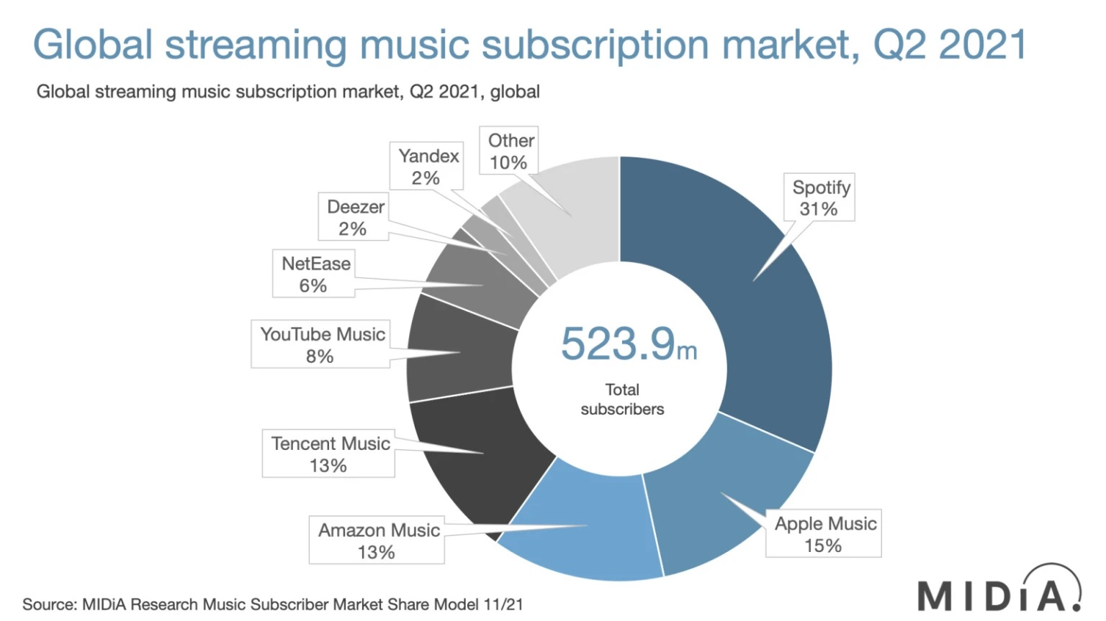

Slide 4
Questions to explore
Analyzing trends in Spotify and how the top songs have changed from 2017 to present.
Studying factors that influence the Spotify Global Top 200 Weekly Charts.
What makes a hit on the Spotify Chart? Is it based on the features of the song like the tempo, time signature, key of the song, how positive or negative the emotion it expresses? Or is it based on what record label the song was released by?
Finally, make predictions for a newly released song’s peak rank and the number of weeks it might spend in the chart based on the analysis.

Slide 5
Spotify Global Top 200 Weekly Charts
Created by Spotify and updated weekly every Friday on the spotifycharts website.
Data contains 200 songs with the highest number of streams in that week.
Contains charts data from 2016-12-23 to 2022-04-22 (over 278 weeks)
Latest Spotify Global Top 200 Weekly Chart: https://spotifycharts.com/regional/global/weekly/latest

Slide 6
Spotify Audio Features
For every song in spotify, it has a database that has the following individual audio features stored:
Danceability (0 to 1)
Energy (0 to 1)
Key (-1 to 11)
Loudness (in dB)
Mode (0 or 1)
Speechiness (0 to 1)
Acousticness (0 to 1)
Liveness (0 to 1)
Instrumentalness (0 to 1)
Valence (0 to 1)
Tempo (in bpm)
Duration (in ms)
Time Signature (¾ to 7/4)
We can get a data frame of audio features for every song in the chart through a library in R called ‘spotifyr’ that uses the Spotify Web API to make an HTTPS request.

Slide 7
Data Wrangling
Combine all of the csv files of 278 weeks into a single csv file.
Get another data frame with just the unique songs from the charts, i.e. 5133 songs and populate it with the audio features call.
Combine the charts data with the audio features data to make a final csv file by joining them by the song id.
For every unique song, find the peak position in the chart, number of weeks spent in the chart, and total number of streams.

Slide 8
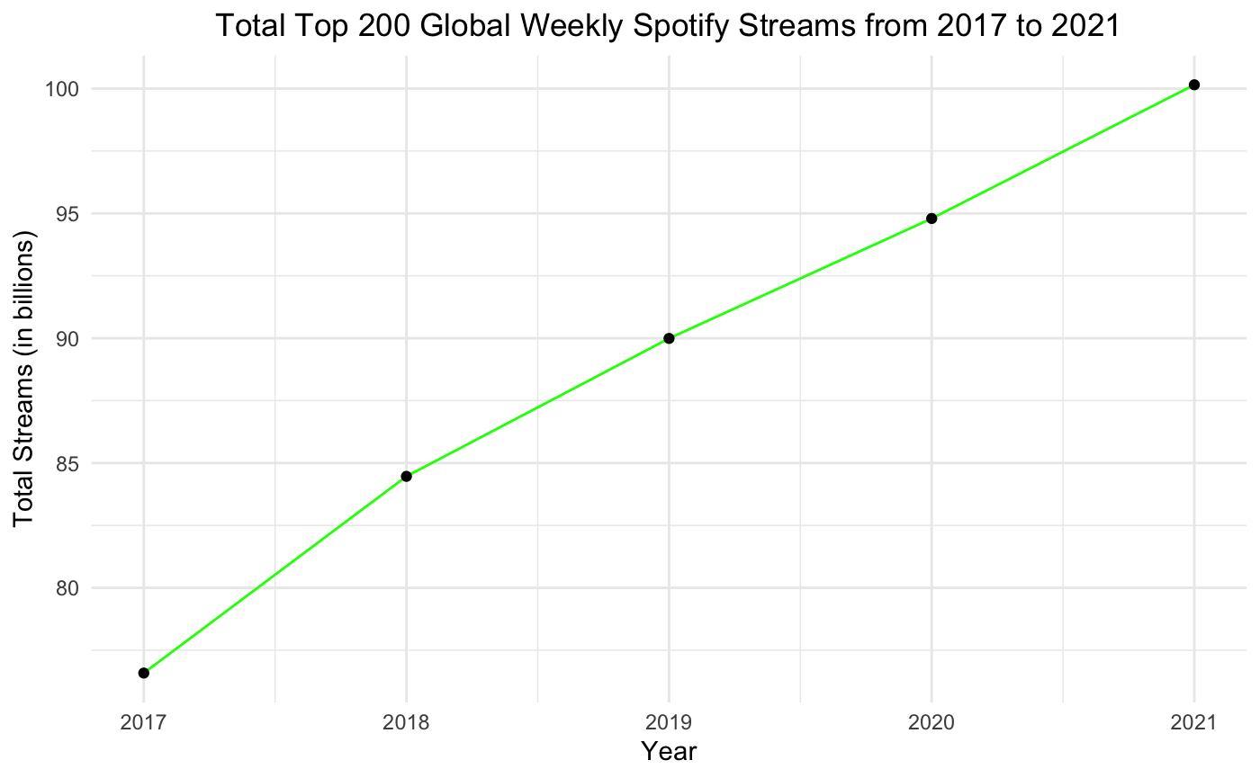

Slide 9
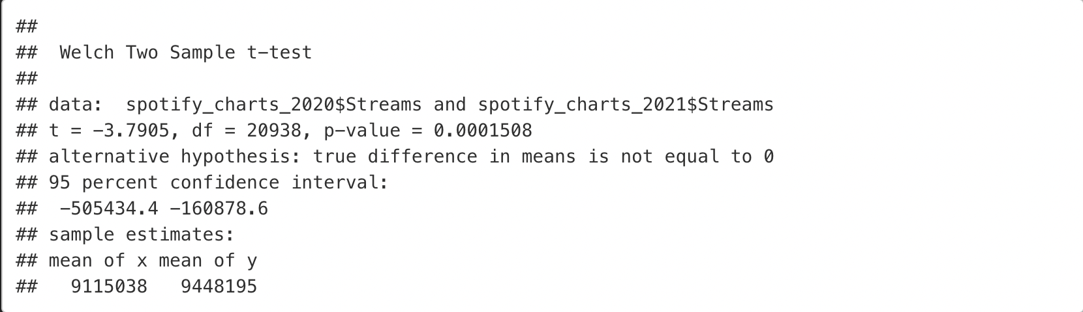
T-Test for mean of total streams in 2020 vs 2021
We have enough evidence to prove that the average total streams in 2020 and in 2021 are different. We can see from the t-test that the mean total streams has increased over the year.

Slide 10
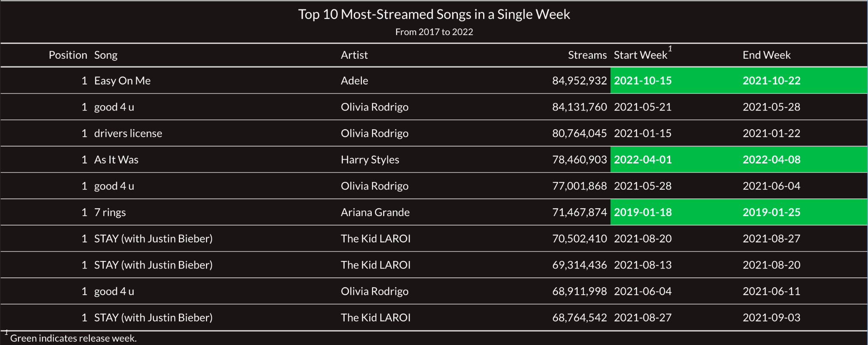

Slide 11

Weekly Top Songs
Global
#1 ALL TIME
Easy On Me
Adele
Danceability | Energy | Key
0.604 | 0.366 | 5 -> F
Loudness | Mode | Speechiness
-7.519 | 1 -> Major | 0.0282
Acousticness | Instrumentalness | Liveness
0.578 | 0 | 0.133
Valence | Tempo | Time Signature
0.13 | 141.981 | 4/4

Slide 12
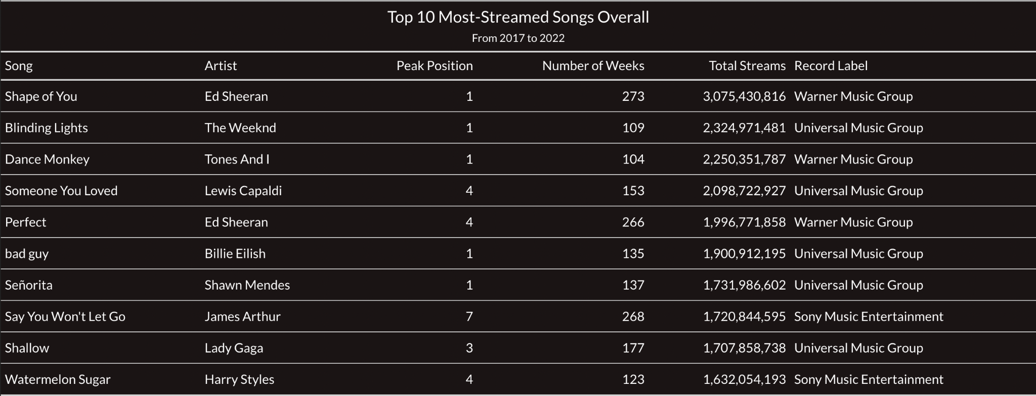

Slide 13

All Time Top Songs
Global
#1 ALL TIME
Shape of You
Ed Sheeran
Danceability | Energy | Key
0.825 | 0.652 | 1 -> C♯/D♭
Loudness | Mode | Speechiness
-3.183 | 0 -> Minor | 0.0802
Acousticness | Instrumentalness | Liveness
0.58100 | 0 | 0.0931
Valence | Tempo | Time Signature
0.931 | 95.977 | 4/4

Slide 14
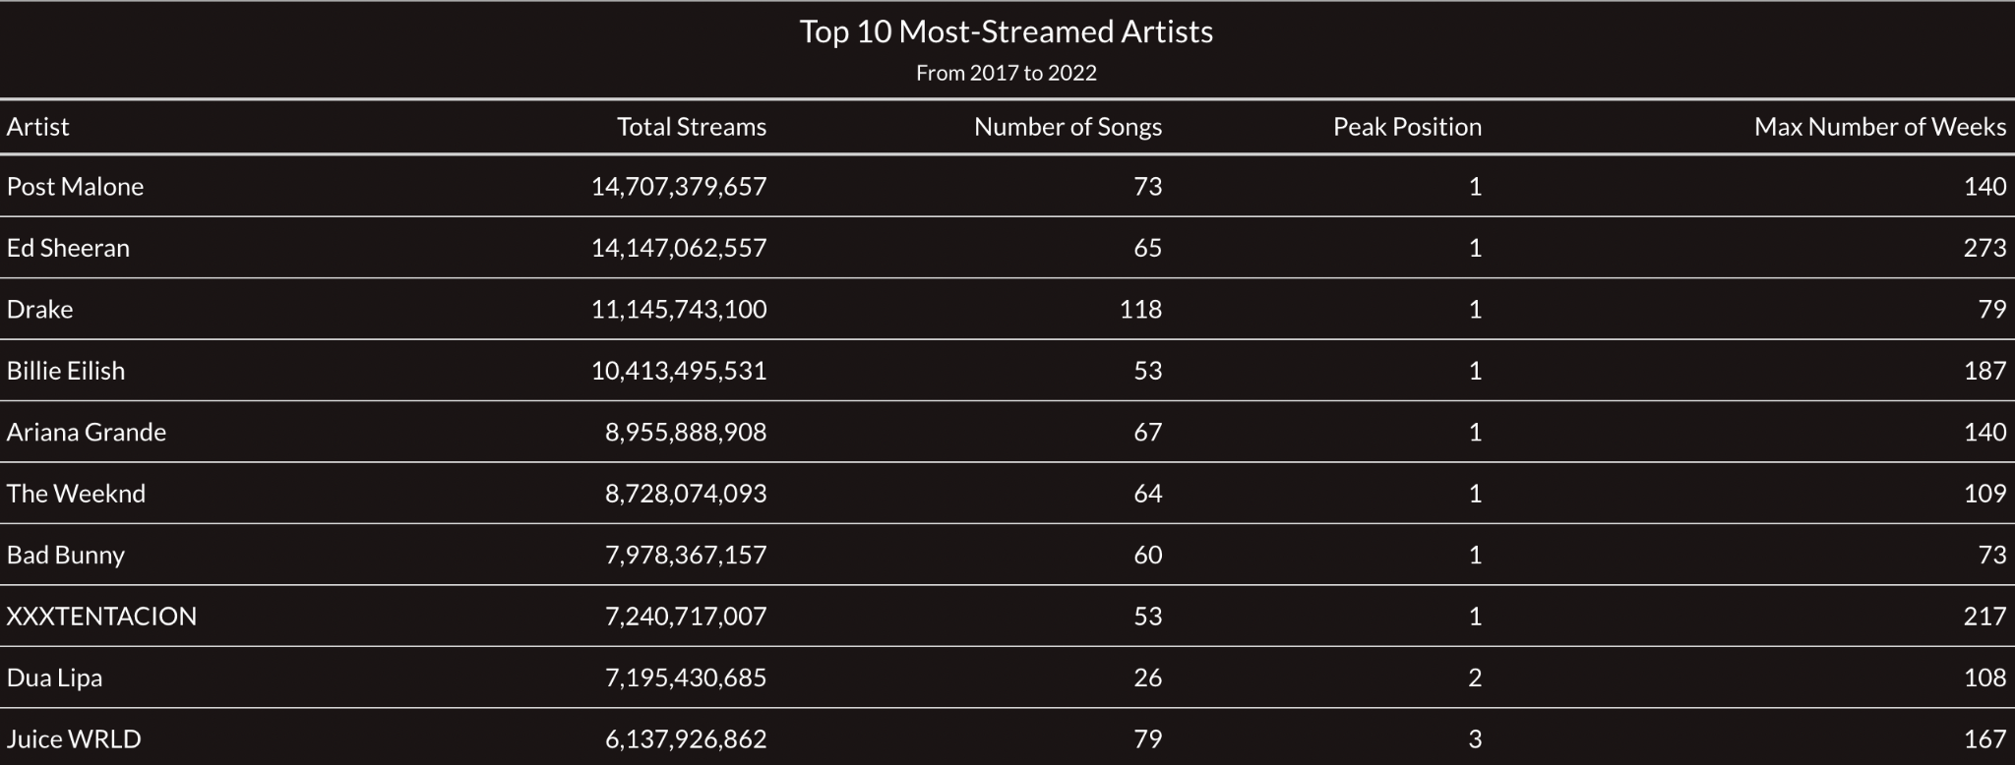

Slide 15
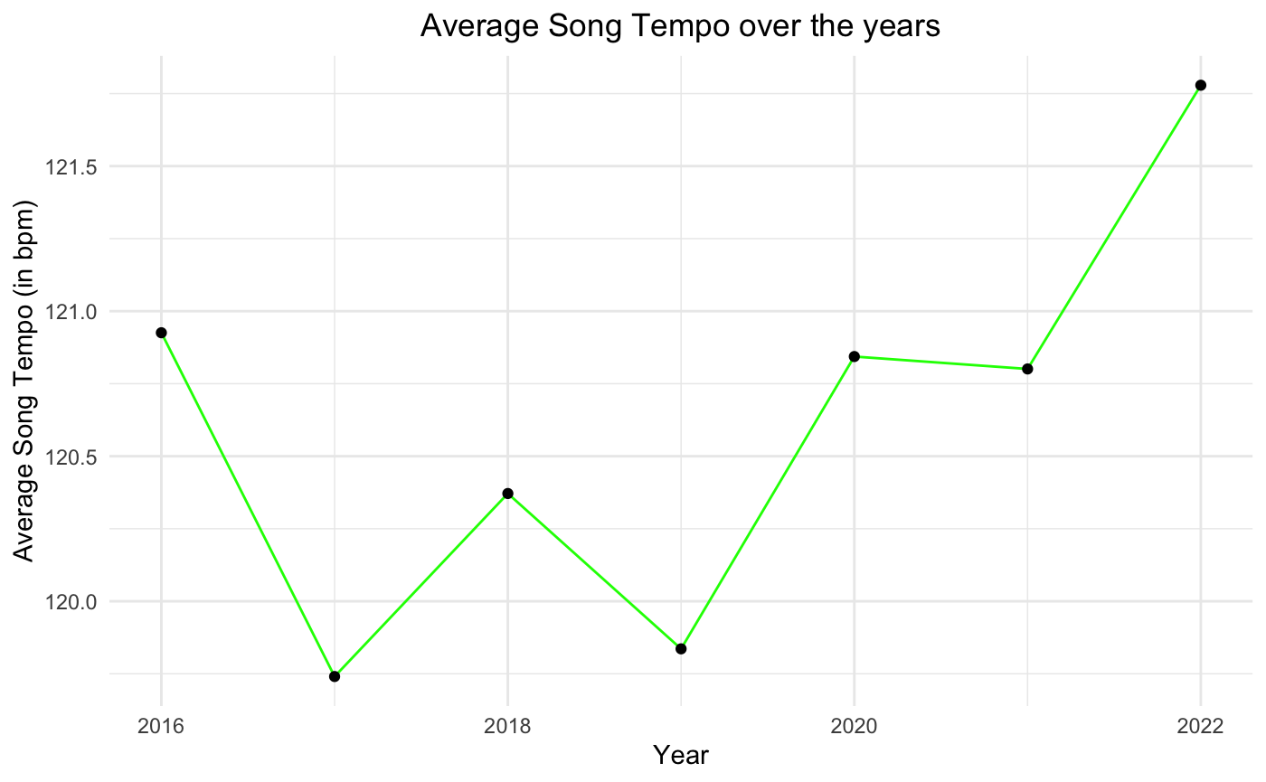

Slide 16
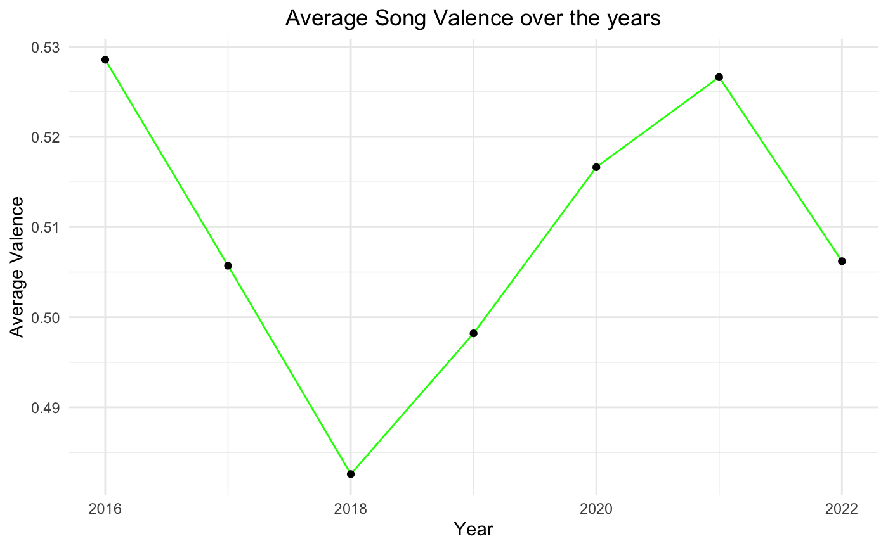

Slide 17
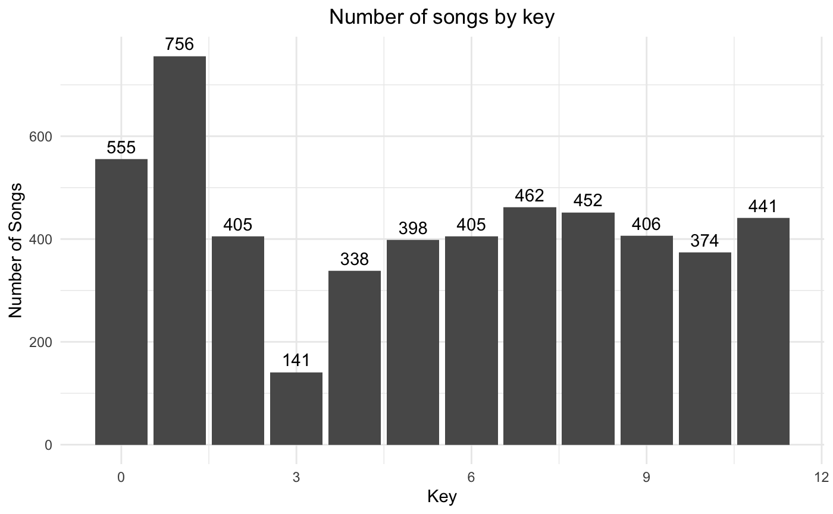

Slide 18
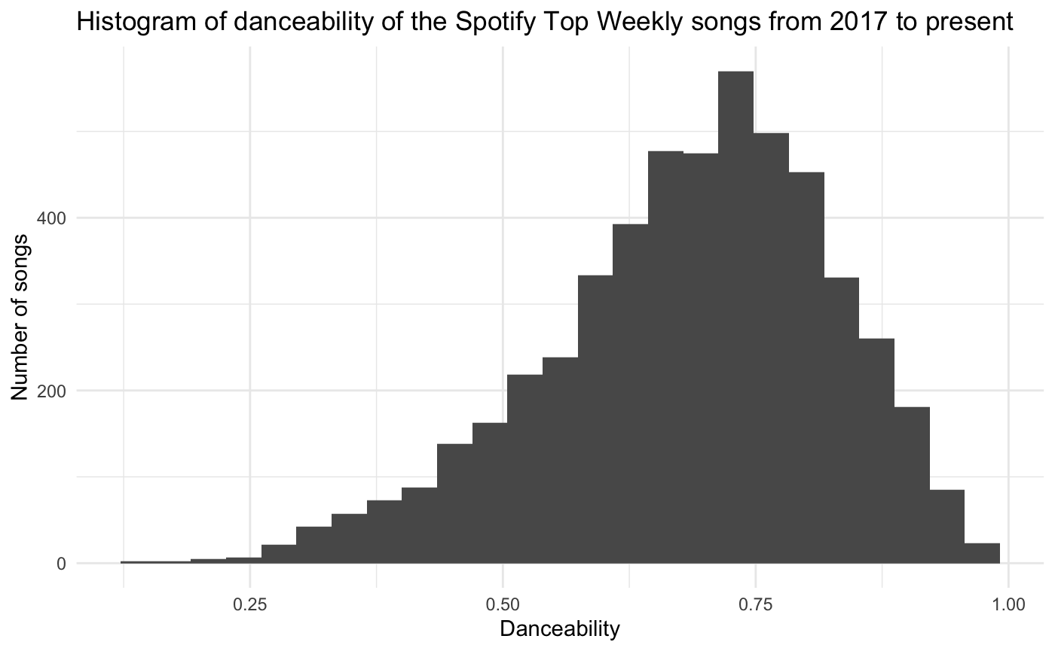

Slide 19
Initial Assumptions
Two dependent variables:
Peak Position:
Highest rank a song achieves in the chart
Ranges from 1 to 200
Helps to track how popular a song was at that point of time
Number of weeks:
Maximum number of weeks a song survives in the chart
Ranges from 1 to 278
Helps to determine the intensity and length of the song’s popularity

Slide 20
Initial Assumptions
After some data exploration, I have assumed that the peak position and the number of weeks variables might depend on some of the audio features.
I feel like songs with the following attributes perform better:
High value of danceability and valence and mild energetic value, as people tend to like feel-good happy songs that make them dance.
Mode of 1 representing a major scale, as it makes the song feel happy and bright.
Low value of instrumentalness, as instrumental songs are lesser popular.
Low value of liveness, as studio recordings are more superior and higher quality.
A song with a key of 1 (C♯/D♭) might perform better, given that it is the most popular key.

Slide 21
Linear Model I

Slide 22
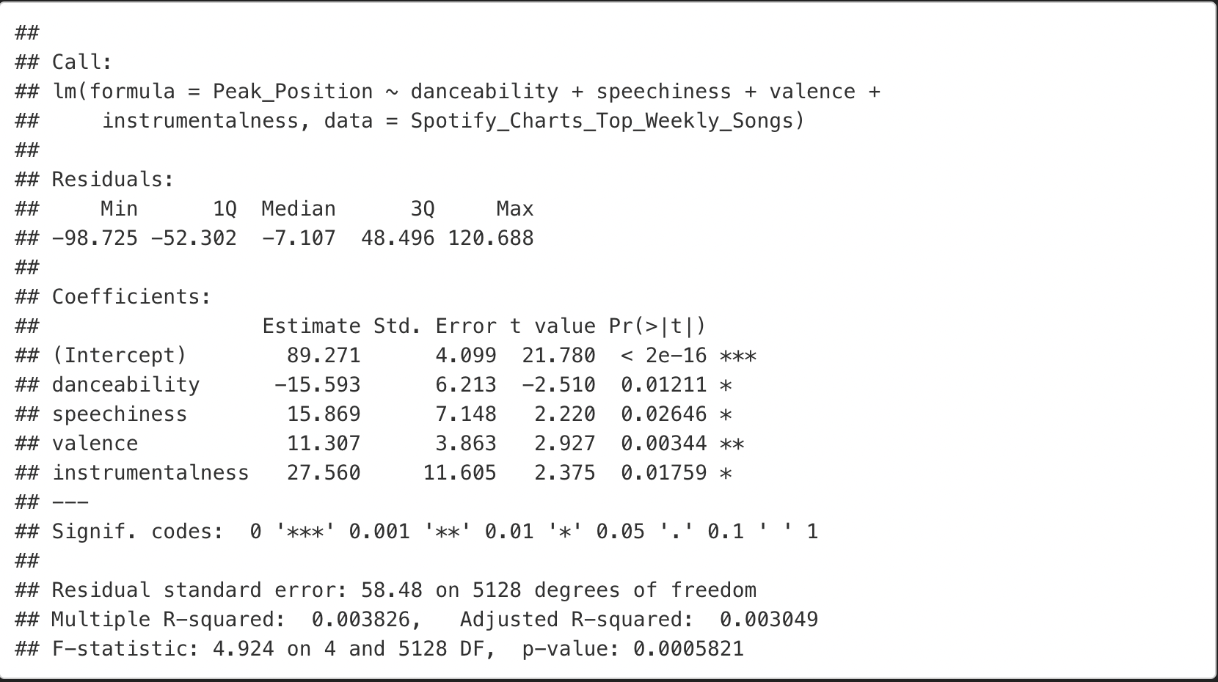
LM-I -> Predicting Peak Position
After checking for collinearity and testing for significance levels, the 1st linear regression model used the following variables: danceability, speechiness, valence, and instrumentalness. (key was removed as it wasn’t that significant and speechiness was added)
The results can be seen in the right. Although the p-values might seem significant (less than 0.05 threshold), the Multiple R-squared doesn’t look promising, as it only accounts for 0.38% of the variance in the data.

Slide 23
Linear Model II

Slide 24
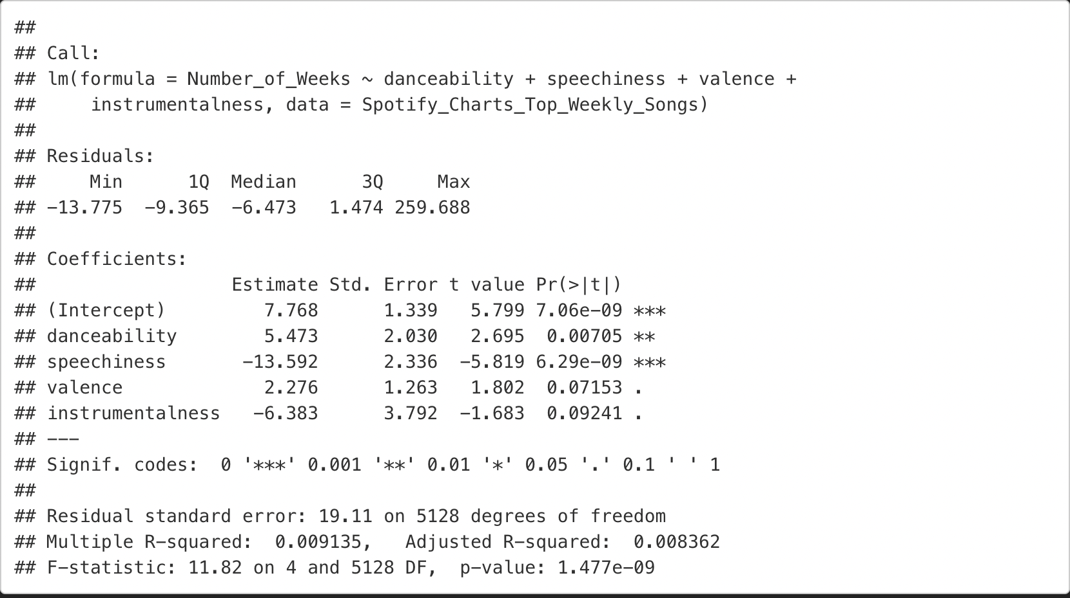
LM-II -> Predicting Number of Weeks
After checking for collinearity and testing for significance levels, the 2nd linear regression model also used the same variables: danceability, speechiness, valence, and instrumentalness.
Similar to LM-I, the results seen in the right, doesn’t look promising. Here only the p-values might for danceability and speechiness seem significant (less than 0.05 threshold) and the Multiple R-squared only accounts for 0.91% of the variance in the data.

Slide 25
Linear Model III

Slide 26
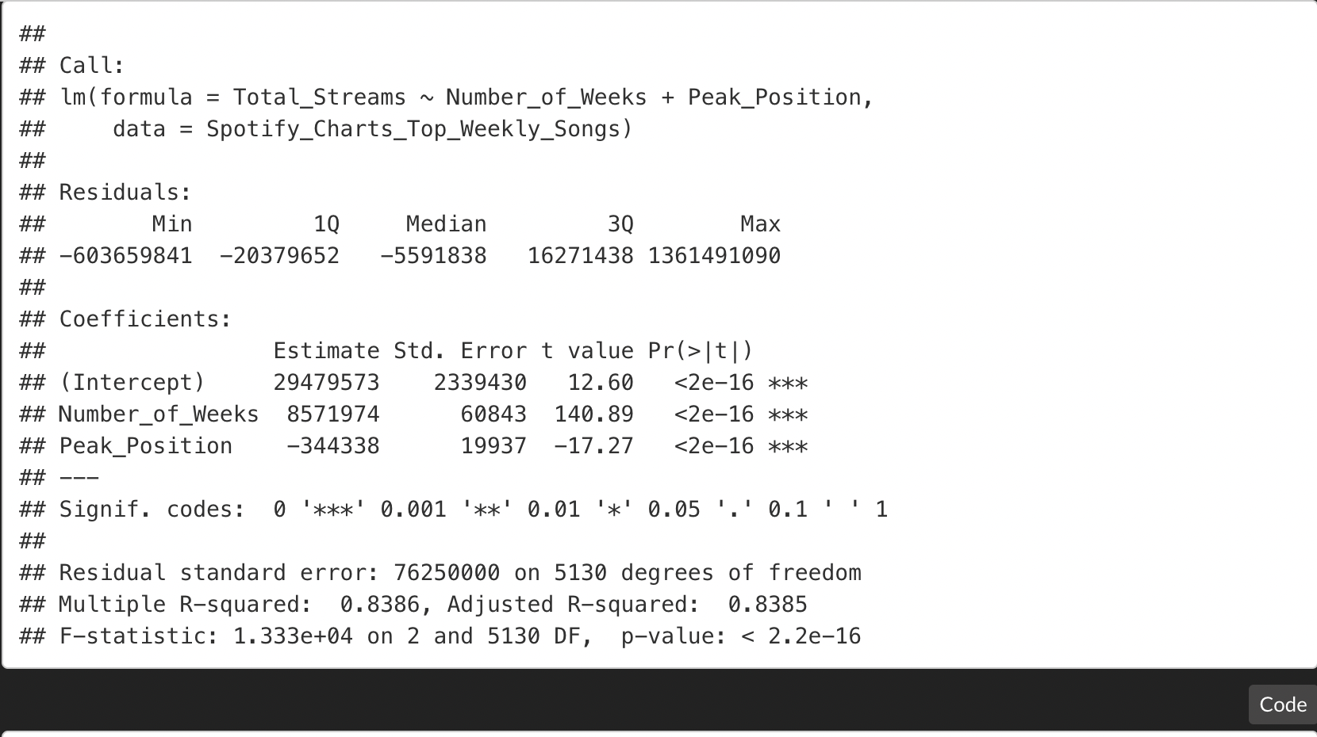
LM-III -> Predicting Total Number of Streams
Finally, I tried to use Total Streams as another dependent variable. For this, I checked if we can predict how much streams a song will get based on the peak position and number of weeks spent in the chart.
This linear model is very promising.
Very significant p-values
Great value for Multiple R-squared of 83.86%.

Slide 27
Testing Predictions

Slide 28

Peak Position = 1
Number of Weeks = 3
Total Streams = 210,842,682
Predicting all 3 Models
#1 GLOBAL
As It Was
Harry Styles
LM - I and II
I used the exact attribute values to predict peak position and number of weeks for “As It Was”. The results:
Peak Position = 89
Number of Weeks = 11
LM - III
Total Streams = 54,851,157
With LM-I and II values:
Total Streams = 93,125,217

Slide 29
Conclusion
Diverse Dataset
What makes a hit?
Music is subjective
Songs not in the weekly charts
Including more variables like gender, genre, record labels, and language of song
No clear formula to make a hit
Other external factors like record label association, promotion, guest artists features, lyrics and melody
Hard to predict the popularity of a song due to unpredictable nature of people and change in trends

